Slide 1
Medicare Part D
Data Viz Midterm Project
Claudia Bardales

Slide 2
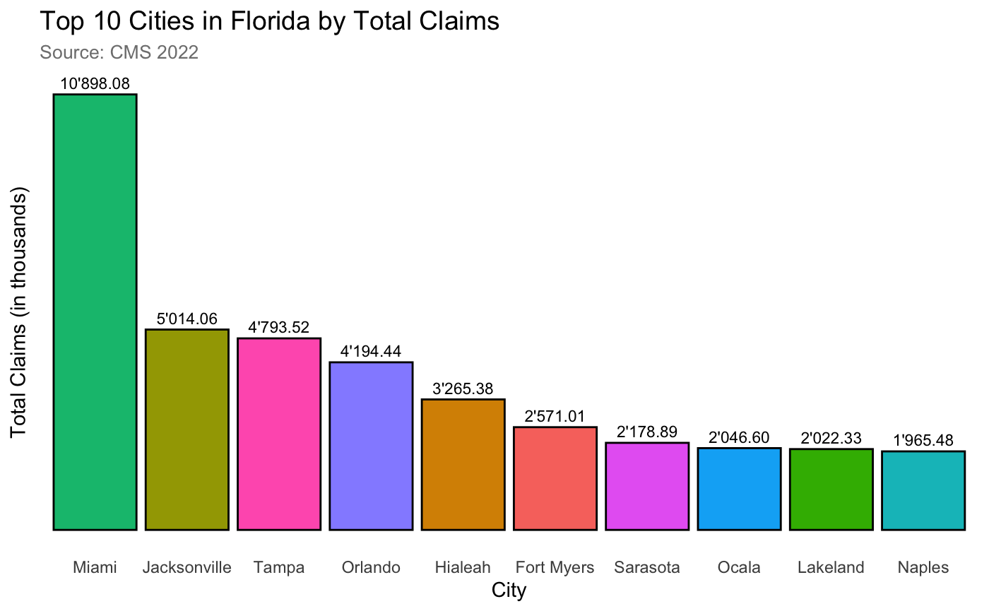
Top 10 Cities in Florida by Claims

Slide 3
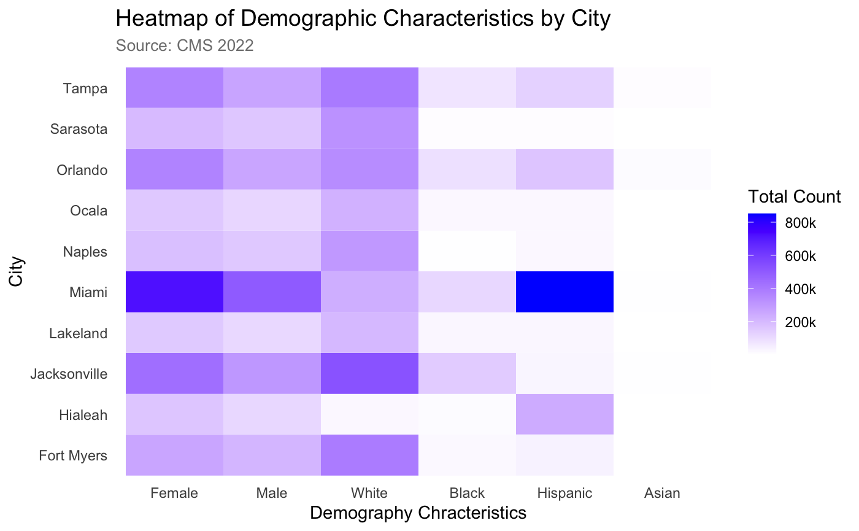
Heatmap of Demographic Characteristics by City

Slide 4
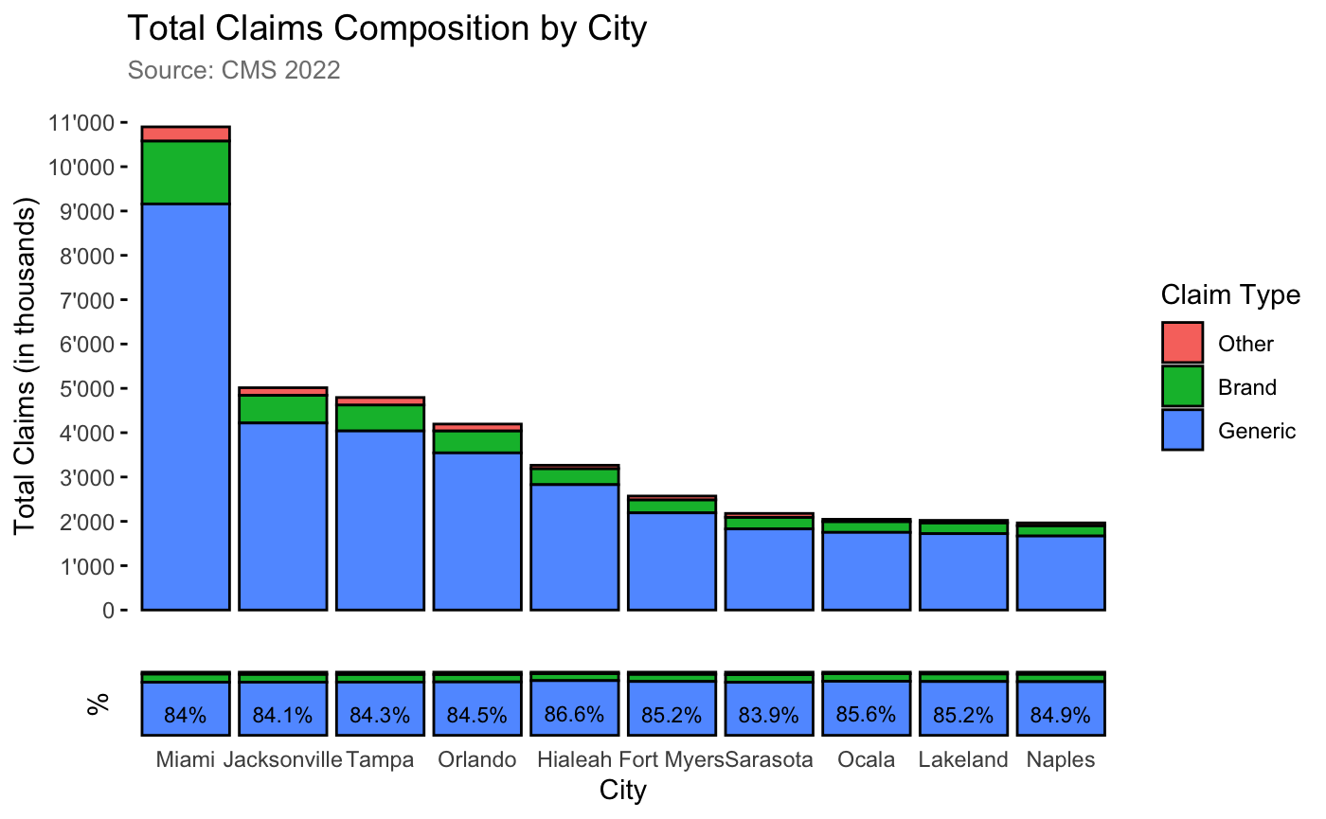
Drug Claims composition by city

Slide 5
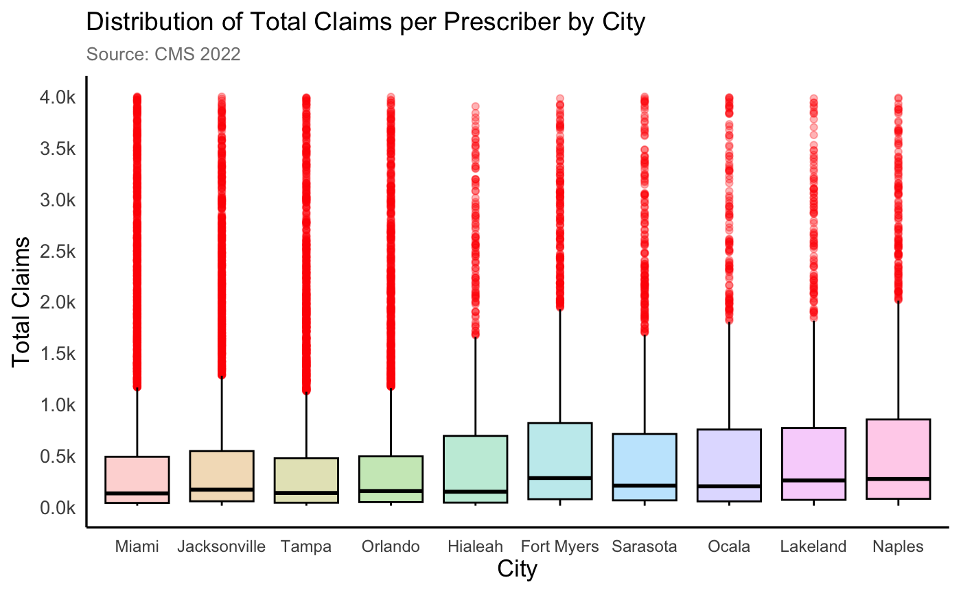
Total Claim per Prescriber by city

Slide 6
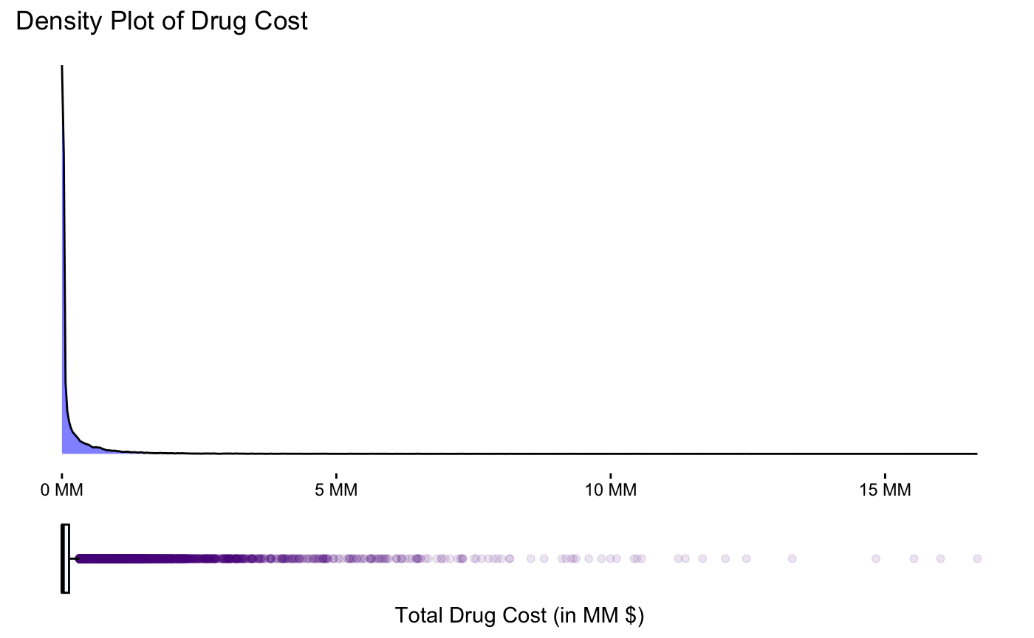
Total Drug Cost

Slide 7
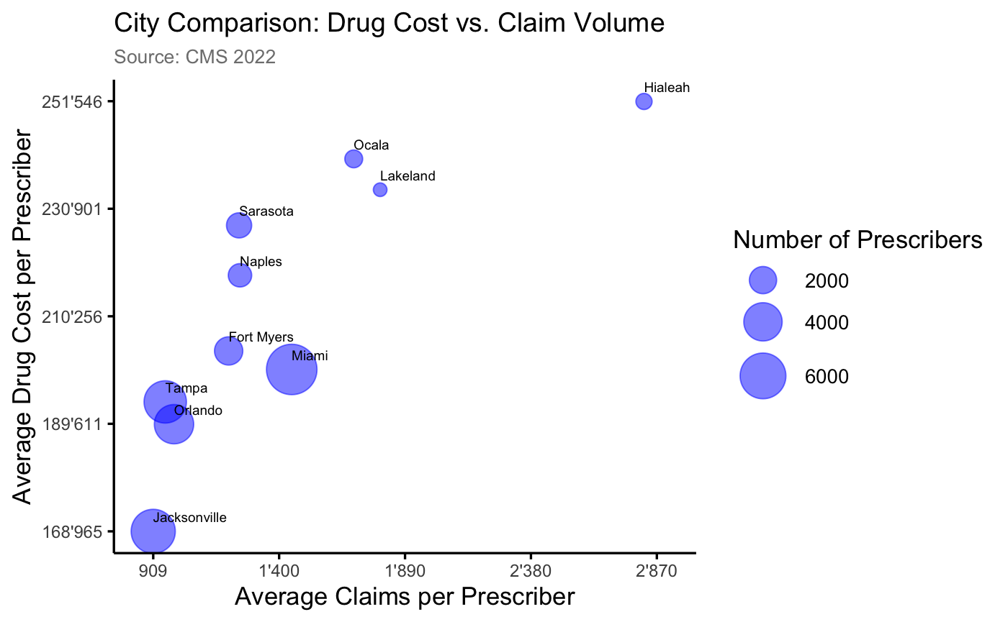
Drug Cost vs Claim Volume

Slide 8
Findings
The majority of Medicare recipients are women. Miami has the largest Hispanic population among recipients. Hispanic and White populations are more evenly distributed across cities.
Generic drugs are dominant, accounting for a total of 84% to 87%.
Ocala, Naples, and Lakeland have lower variability in claims per prescriber, which suggests more consistent prescribing behavior compared to cities like Miami, Hialeah, and Fort Myers.
The number of outliers in cities such as Miami and Hialeah raises questions about prescribing patterns, with fewer prescribers filing a high number of claims. While most claims are low-cost, a small number of prescribers are increasing the overall cost.

